Slide 1


Ask Us Anything Session
Learn more about INPACE
Dr Svetlana Klessova
Project coordinator
G.A.C. Group (France)
22 January 2026
©INPACE 2024-2027

Slide 2
Agenda
INPACE Presentation (20-25 minutes)
  About INPACE: Mission, key figures, and goals
  The INPACE Hub
  Thematic Working Groups (TWGs) and Clusters
  INPACE Virtual fair
  Opportunities for collaboration with INPACE
  Pilot projects
  2nd EU-Japan Digital Week 2026
Q&A session (35-40 minutes)

Slide 3

Context
Why is INPACE important?
1
2
3
The EU aims to strengthen its connection to the Indo-Pacific region for research, innovation, technology deployment, regulation alignment, and supply chain stability.
Promotion of digital technologies being one of the highest priorities, the EU has established Digital Partnerships with Japan (2022), the Republic of Korea (2022) and Singapore (2023), and a Trade and Technology Council (2022) with India.
The goal is that society and businesses in both regions benefit from opportunities in the growing global digital economy.
©INPACE 2024-2027

Slide 4

INPACE: key figures
Coordination and Support Action
January 2024 - June 2027 (3,5 years)
21 consortium partners
13 Asian and European countries
Funding: Horizon Europe and Swiss State Secretariat for Education, Research, and Innovation SERI

Slide 5

Mission
What is INPACE aiming to achieve?
The mission of INPACE is to support digital partnerships and the Trade and Technology Council and to contribute to the deepening of the collaboration between Europe and India, Japan, the Republic of Korea and Singapore in the domain of digital technologies and their application for the well-being of the citizens in Europe and in the Indo-Pacific region.
New International Digital Strategy for the EU
https://digital-strategy.ec.europa.eu/en/library/joint-communication-international-digital-strategy-eu
©INPACE 2024-2027

Slide 6


Join the INPACE Hub:
Your gateway to Europe-Indo-Pacific digital collaboration
The INPACE Hub is an innovative digital platform that brings together technology and policy specialists with validated resources, collaboration opportunities, and expert connections.
Join the Hub to:
Create synergies with your own projects and initiatives – propose joint activities, promote your technologies, and more
Tap into expert networks spanning multiple regions
Access validated resources/knowledge hub, and funding opportunities
Foster impactful digital initiatives with your involvement, including at core roles!
Advance trusted digital technologies for sustainable well-being
Discover the INPACE Hub and register:
https://egcp.enrich-global.eu/communities/inpace
©INPACE 2024-2027

Slide 7
Hub Services and Value
Services/factures | Description | Benefit
Expert connection, inc. dedicated groups (free*) | Directory searchable by country, topic and organisation | Quick access to relevant partners, speakers, experts…
Shared workspace (free*) | Secure repository with online co-editing – collaborative tool | One common, updated version
Event management and analytics (free*) | Tools to publish news, announce and manage events incl. registrations and analytics | Greater visibility Easy management of the events “Exit questionnaires”
Communication (free*) | Real-time document co-creation and workspaces for groups | Regular engagement within communities
Knowledge repository and (free*) | Long-term access to documents and results of your projects | Preservation and reuse after the project ends
Matchmaking (free*) | Search by expertise and interest | Support for new joint initiatives
Virtual fair (paid) | 3D virtual expo | Showcase your products and technologies temporary or permanent link for your usage
*Free in DIY (do it yourself) mode.
©INPACE 2024-2027

Slide 8
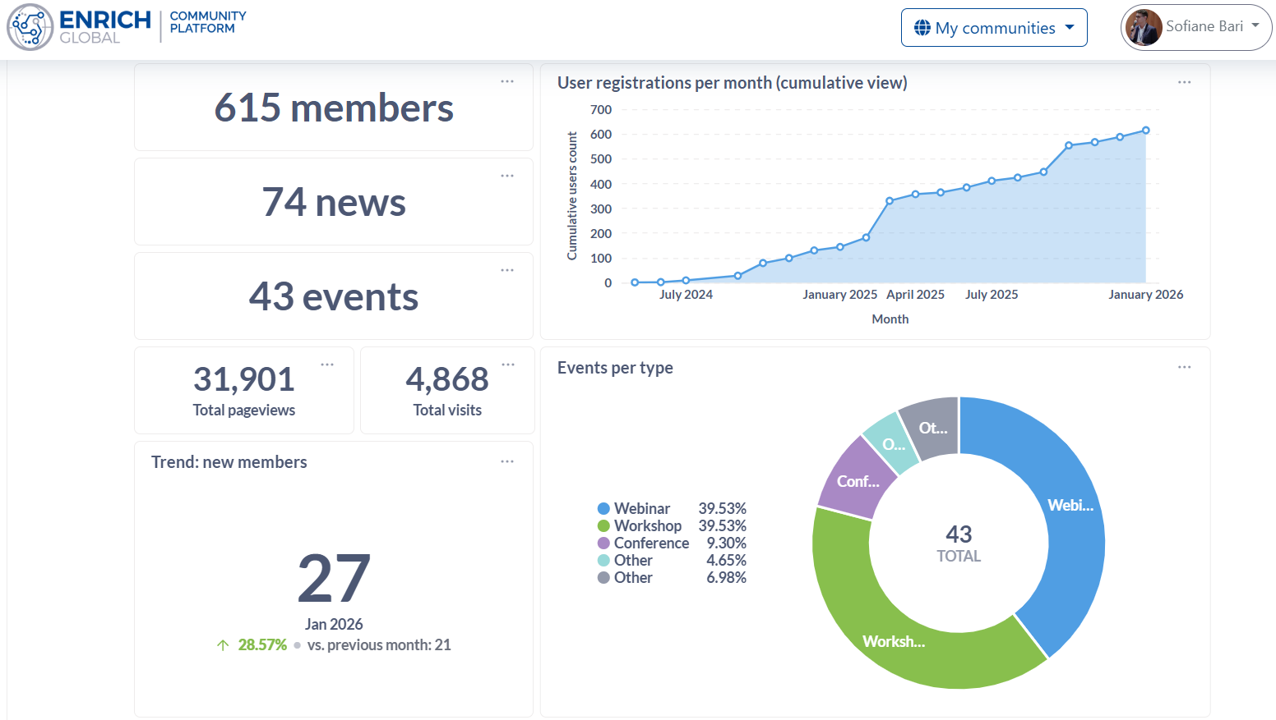
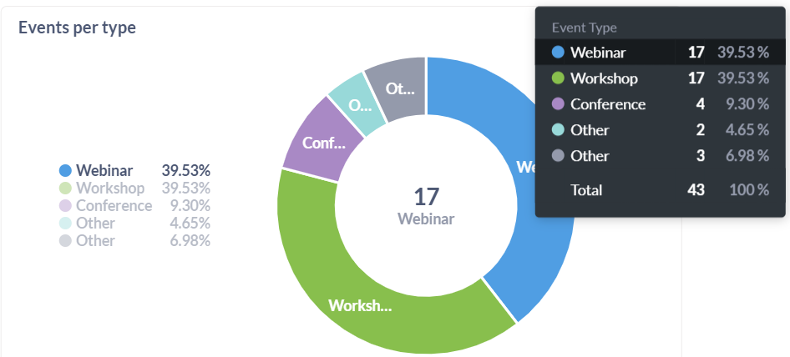
INPACE Hub Key Figures (Dashboard*)
*As of 20.01.2026
©INPACE 2024-2027

Slide 9

Thematic Working Groups
INPACE organises exchanges through Thematic Working Groups that bring together experts from industry, associations, government institutions and the research communities from the partner countries and Europe.
Their mission is to foster joint research and innovation, business collaboration, market opening, policies collaboration, and to support the implementation of the Digital Partnerships and the Trade and Technology Council with the partner countries.
©INPACE 2024-2027

Slide 10
Thematic Working Groups & Clusters
5G and beyond
Internet of trust and security
Smart continuum
1
Standardisation
Policy dialogues
Joint programming
Digital education and skills
5
Digital dialogues, policies and education
Digital technologies - future networks
INPACE HUB Knowledge platform and Community Platform.
Innovation and entrepreneurship for sustainable well-being
Public administrations, infrastructures and services
Digitalisation of industry and supply networks
Enabling technologies - chips for the future
2
Advanced computing
Advanced functionalities
Ground-breaking technologies
4
Digital technologies - trustworthy decision support
Trusted AI
Data technologies
High performance computing
3
©INPACE 2024-2027
10

Slide 11
Expected outcomes of INPACE
Harmonized research and innovation funding programs and joint calls
Reduction of barriers for trade and commercialization of new digital technologies
1
2
3
4
Convergence on principles in regulation, legislation, and standards for digital technologies and new joint major policy initiatives between the EU and the Indo-Pacific region
Long-term collaborations in the field of digital technologies and their applications
©INPACE 2024-2027

Slide 12
Virtual fairs
The virtual fair and marketing support is offered to selected organisations by INPACE Hub, as part of European Indo-Pacific Digital Partnerships.
Requirements:
Locations: organisations registered in Europe, India, Japan, ROK, Singapore
Focus of technologies/products: in line with the focus areas above
Technology readiness: TRL 8 or above (market-ready or near-market solutions)
Feedback: provide to our team brief feedback about your experience
Transform your market presence with a virtual stand that operates 24/7, reaching your Indo-Pacific and European prospects, potential partners, and investors.
Ready to showcase your innovation to European and Indo-Pacific markets?
Contact us: eselcuk@enrich-global.eu and info@inpacehub.eu

Slide 13
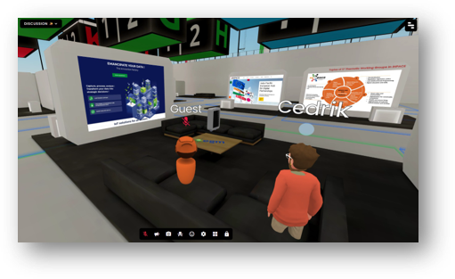
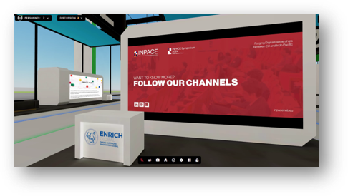
Virtual fairs
INPACE Virtual Fair is designed to connect mature European and Indo-Pacific innovations (technologies and products) through an immersive 3D environment.
Key focus areas:
Trustworthy AI
Semiconductors & advanced chip technologies
Secure IoT & infrastructure protection
Digital identities & trust systems
6G networks & communication infrastructure
What you receive at no cost for you:
Professional 3D virtual booth on INPACE virtual expo center
Marketing and PR support
Six months of exposure with all costs covered by European funding

Slide 14
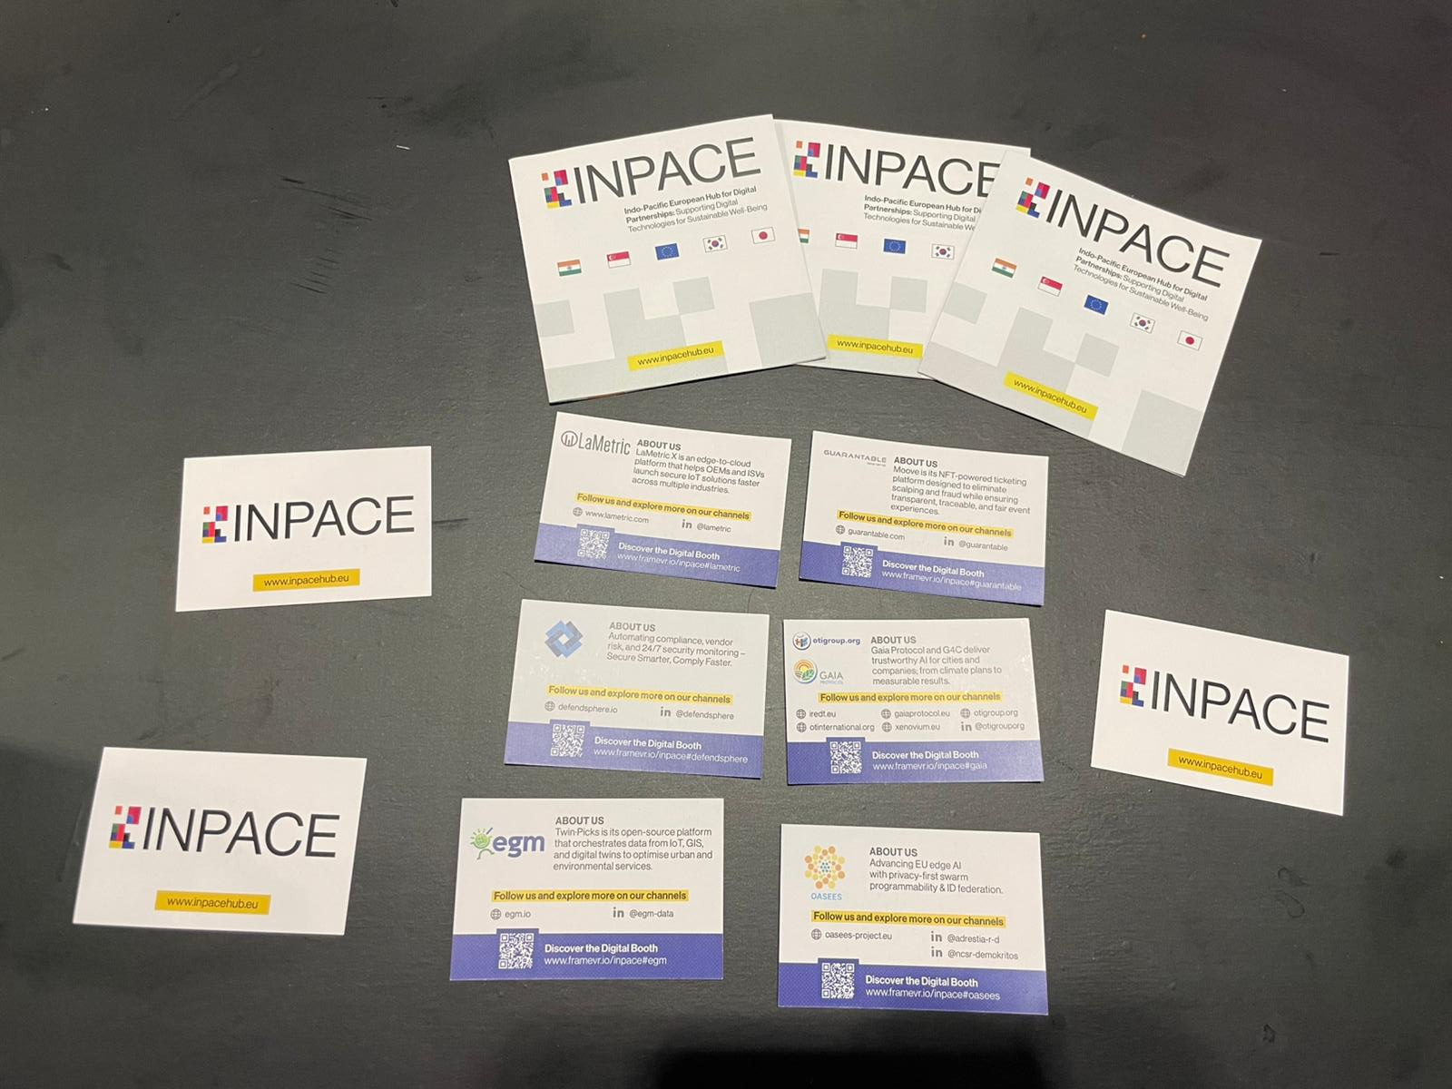


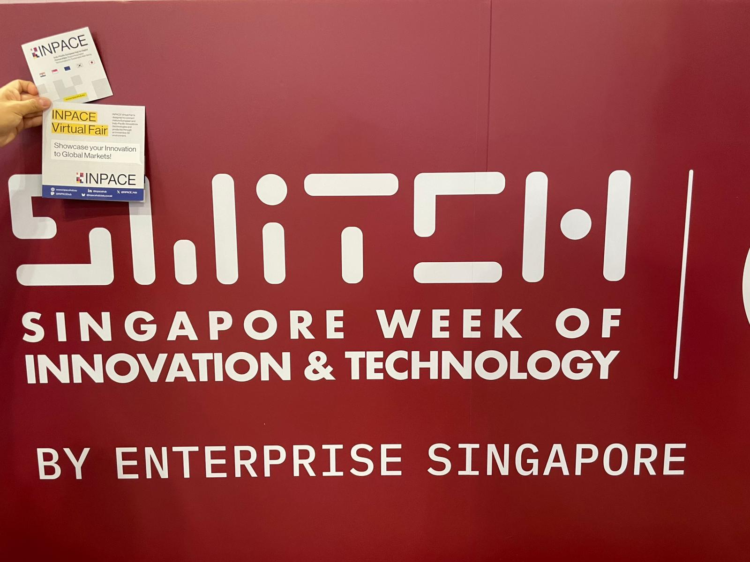







1st Virtual Fair Successfully Delivered!
The 1st INPACE Virtual Fair was launched in testing mode in July 2025, with 7 companies which were accepted for participation.
Communication Support: the companies were promoted during the EU-Indo-Pacific Digital Partnership Conference 2025 (Singapore) and SWITCH Singapore
150+ visits in the 1st edition of the Virtual Fair
Feedback from a participant: “Everything looks great. It’s really interesting to explore the exhibition, and I appreciate that you included our project in this initiative”
Stay tuned!
2 more editions are planned: Autumn 2026 and Spring or Summer 2027

Slide 15

Share our passion for digital technology and international collaboration?
We are looking to connect with RIA and IA projects that:
  develop technologies and solutions of potential interest for the Indo-Pacific region
  advance innovation in key areas such as AI, 5G/6G, and other emerging digital technologies
Interested? Visit: https://inpacehub.eu/engage-with-us/

Slide 16
What's in it for you?
Examples of opportunities
Get your technologies or your project activities promoted on our channels and on our INPACE Hub: take part in our virtual fairs, co-organise webinars, connect with policymakers and industry leaders…
Position yourself (your project) as a speaker at our events – an opportunity to shape future cooperation frameworks between different regions.
Contribute to pilot projects: In October 2024, INPACE kicked off a successful first Symposium in Seoul, Republic of Korea, strengthening EU-Indo-Pacific digital collaboration.
  The symposium enabled the consortium to develop targeted pilot project strategies, helping to turn proposed frameworks into practical implementation plans.
  From 31 March until 7 April 2025, the EU-Japan Digital Week took place in Tokyo, organised as part of the EU-Japan Digital Partnership.
  On 28-29 October 2025, the EU-Indo-Pacific Digital Partnership Conference brought together key stakeholders to discuss and advance the cooperation between the EU and Indo-Pacific countries in the field of digital technologies and their application.

Slide 17
Pilot projects
We are looking to connect with RIA and Move from talk to action
Actions which are seeds for following interactions and projects
6 done / on-going / under preparation:
✓
Cross-domain data exchange PlugTest (2025)
​Digital Public Infrastructure Interoperability Hackathon (2025)
➲

Disruptive semiconductor technologies testbed
NICT/ESA project on 6G in non terrestrial networks
Digital Public Infrastructure interoperability hackathon (Tokyo 2026)
​AI-Ready data Challenge (Seoul 2026)
©INPACE 2024-2027

Slide 18
Digital Public Infrastructure interoperability hackathon
Focus on Digital identity, dataspace, context information
Projects encouraged to:
  Engage team
  Provide tech support
  Webinars to propose their stack to participants
  Suggest challenges
Starts mid-February
Final pitches end of March
Remote and online participation encouraged.

Slide 19
AI-Ready data Challenge
Build upon data quality metrics under definition at ETSI
Event concept not yet fixed
Projects welcome to suggest ideas and join
Physical event, mid-september 2026 – Seoul
2 days on-site
Contacts:
  Prof. JaeSeung Song (jssong@sejong.ac.kr)
  Franck Le Gall
  (franck.le-gall@egm.io)

Slide 20
2nd EU-Japan Digital Week 2026
23 March - 30 March 2026 in Tokyo, Japan
The EU-Japan Digital Week is the annual flagship event of the EU-Japan Digital Partnership.
Focus areas
AI & emerging technologies
Semiconductors, quantum computing, high-performance computing
Digital infrastructure, standardisation, cross-border interoperability
What to expect
Thematic workshops, high-level dialogues, hands-on training sessions, hackathon, stakeholder roundtables
Key themes
AI for societal good
Trusted data spaces
Cybersecurity
Digital diplomacy
This event will bring together key stakeholders from government, industry and businesses, academia and research, and policymaking across the European Union, Japan, and other Indo-Pacific countries.
Learn more: https://inpacehub.eu/eu-japan-digitalweek-2026
©INPACE 2024-2027

Slide 21
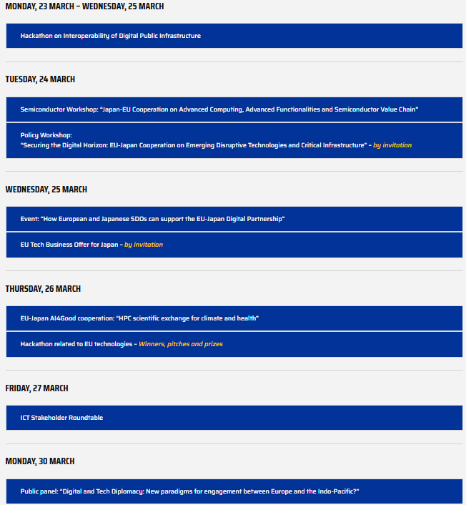
2nd EU-Japan Digital Week 2026: Schedule
©INPACE 2024-2027

Slide 22



Keep in touch with us!
@INPACEHub
info@inpacehub.eu
@INPACE_Hub
www.inpacehub.eu
@INPACE
Join the INPACE Hub!
https://egcp.enrich-global.eu/communities/inpace
©INPACE 2024-2027
22

Slide 23




Thank you
The INPACE project has received funding from the European Union’s Horizon Europe Research and Innovation Programme under grant agreement 101135568. Funded by the European Union (INPACE, 101135568). Views and opinions expressed are however those of the author(s) only and do not necessarily reflect those of the European Union. Neither the European Union nor the granting authority can be held responsible for them. This work has received funding from the Swiss State Secretariat for Education, Research and Innovation (SERI).

Slide 24
Q&A Session

